Slide 1

Research Proposal Presentation
Student name: Damith Rathnayaka
Student Number: 12691084
Module : Research method & professional Practice – March 2024

Slide 2
Overview Of The Presentation
The research proposal presentation will answer below questions,
How and why, I selected this research topic ? My research aim and objectives ?
How will this contribute to the research discipline?
What are the research questions?
How I will be analysing current literature?
How relevant my research design and methodology to the selected topic?
What is my planned data collection and analysis method?
What are the practical challenges in my research ? Ethical considerations.
What is the timeline of my research project?

Slide 3

Research Topic Selection:
Cyber Security Body of Knowledge : CyBOK Knowledge Areas
Human, Organisational & Regulatory Aspects
Human factors
Cyber Security Awareness and Education
An Evaluation Of Cybersecurity Awareness And Education Levels Among International University Students In The UK

Slide 4
Research Topic Selection:
Cyber Security Body of Knowledge : CyBOK Knowledge Areas
Human, Organisational & Regulatory Aspects
Cultural Backgrounds, Opinions and Attitudes Towards Cybersecurity Education
International students in UK universities
Security Awareness
Security Education
Online Learning Platforms
Cyber Security User
Behaviour
Security Training
An evaluation of cybersecurity awareness and education levels among international university students in the UK

Slide 5

Key Contributions To The Research Discipline
The study will offer valuable knowledge to address and prevent human-related cybersecurity risks by understanding cross cultural differences on cybersecurity awareness and education.
Research findings will uncover gaps and misunderstandings on cybersecurity knowledge among international students.
Research will provide reliable recommendations to universities, and cybersecurity professionals on developing cybersecurity awareness and education campaigns for international university students in the UK.

Slide 6

Research Questions
How do international students see the importance of cybersecurity awareness and education for their academic and career development?
What are the most common misunderstandings or knowledge gaps in cybersecurity among international university students in the UK?
What recommendations can be provided to improve cybersecurity awareness and education among overseas university students in the UK?

Slide 7

Research Aims And Objectives
Aims
Objectives
Investigate the international university students in the UK to identify their education levels and awareness of cybersecurity.
Evaluate how cultural origins, previous knowledge, and experience influences cybersecurity awareness and education.
Evaluate whether availability of resources and institutional support affects students' cybersecurity awareness and education.
Identify knowledge gaps and misunderstandings in cybersecurity among international university students in the UK.
Identify best strategies for improving cybersecurity awareness and knowledge among overseas students.

Slide 8

Key Literature Related To The Project
Different Definitions Of Cybersecurity Awareness.
Different Definitions Of Cybersecurity Education.
Previous Research Papers On Cybersecurity Awareness And Education
Different Theories of Cybersecurity Awareness And Education
Academic Papers on Different Concepts on Cybersecurity Awareness And Education In Higher Education Settings
Academic Papers on Different Models To Understand Cybersecurity Awareness And

Slide 9

Research Design and Methodology
Research
Research Design
Research Methodology
Quantitative Approach
Sampling Strategy
Online Questionnaire
Descriptive Statistics

Slide 10

Sampling Strategy, Data Collection, Data Analysis Methods
Research
Random Sampling
Data Analysis
Sampling Strategy
Online Questionnaire
Descriptive Statistics

Slide 11

Limitations of The Research
Variations in data quantity:
The limited number of data gathered through small samples are less credible and has an impact on the ability to apply study results to wider populations (Mcleod, 2022).
Reliability of data:
The reliability of results is limited because the researchers have limited control over who and how many people responses (Lefever, Dal and Matthíasdóttir, 2007).
Sampling Issues:
Percentages of student email addresses collected per university will be varied considerably, making a random sample impossible (Lefever, Dal and Matthíasdóttir, 2007).

Slide 12







Ethical Considerations
General Research Ethics
Online Research Ethics
Participant’s consent
freedom of expression, human rights
Independence & well being
Data privacy & security and data integrity
security
anonymity and confidentiality

Slide 13
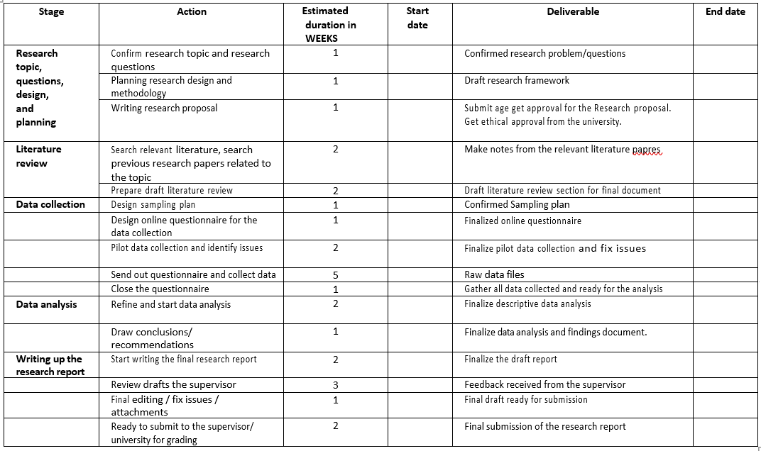
Research Project Timeline

Slide 14
Reference
Alhasan, I.Y. (2023) Human Factors in Cybersecurity: A Cross-Cultural Study on Trust. Available from: https://hammer.purdue.edu/articles/thesis/Human_Factors_in_Cybersecurity_A_Cross-Cultural_Study_on_Trust/23271581/1 [Accessed 1 May 2024].
Bouchrika, I. (2023) How to Write a Research Question: Types, Steps, and Examples. Available from: https://research.com/research/how-to-write-a-research-question . [Accessed 1 May 2024].
Buchanan, E.A. & Zimmer, M. (2021) Internet Research Ethics. Summer 2021 ed. [online] Stanford Encyclopaedia of Philosophy. Available from: https://plato.stanford.edu/entries/ethics-internet-research/#KeyEthiIssuInteRese. [Accessed 1 May 2024].
Jeong, J., Mihelcic, J., Oliver, G. and Rudolph, C. (2019) Towards an Improved Understanding of Human Factors in Cybersecurity. 2019 IEEE 5th International Conference on Collaboration and Internet Computing (CIC). DOI: https://doi.org/10.1109/cic48465.2019.00047.
Kaur, J., and Kumar K.R. R. (2021) The Recent Trends in Cybersecurity: A Review. Journal of King Saud University - Computer and Information Sciences 34(8): DOI: https://doi.org/10.1016/j.jksuci.2021.01.018.

Slide 15
Reference
Kurzhals, K. (2021) Quantitative Research: Questionnaire Design and Data Collection. Resource Recombination in Firms from a Dynamic Capability Perspective: 177–207. DOI: https://doi.org/10.1007/978-3-658-35666-8_5.
Larson, M.G. (2006) Descriptive Statistics and Graphical Displays. Circulation 114(1): 76–81. DOI: https://doi.org/10.1161/circulationaha.105.584474.
Lefever, S., Dal, M. and Matthíasdóttir, Á. (2007) Online Data Collection in Academic research: Advantages and Limitations. British Journal of Educational Technology 38(4): 574–582.
Lowhorn, G.L. (2013) Qualitative and Quantitative Research: How to Choose the Best Design. SSRN. Available from: https://papers.ssrn.com/sol3/papers.cfm?abstract_id=2235986.
Mcleod, S. (2022) Qualitative vs Quantitative Research: Methods & Data Analysis. Simply Psychology. Available from: https://www.simplypsychology.org/qualitative-quantitative.html#What-Is-Quantitative-Research.
Priority Management (2021) Why are Project timelines important? [online] Available from: https://www.prioritymanagement.com.au/why-are-project-timelines-important/.

Slide 16
Reference
Regmi, P.R., Waithaka, E., Paudyal, A., Simkhada, P. and Van Teijlingen, E. (2016) Guide to the design and application of online questionnaire surveys. Nepal Journal of Epidemiology 6(4):640–644. Available from: https://www.ncbi.nlm.nih.gov/pmc/articles/PMC5506389/.
Sileyew, K.J. (2019) Research Design and Methodology. www.intechopen.com. Intech Open. DOI: https://doi.org/10.5772/intechopen.85731.
Snyder, H. (2019) Literature Review as a Research methodology: an Overview and Guidelines. Journal of Business Research 104(1): 333–339. DOI: https://doi.org/10.1016/j.jbusres.2019.07.039.
Sugiura, L., Wiles, R. and Pope, C. (2017) Ethical challenges in online research: Public/private perceptions. Research Ethics 13(3-4):184–199. DOI: https://doi.org/10.1177/1747016116650720.
Swanson, R.A., and Holton, E.F. (2005) Research in Organizations: Foundations and Methods of Inquiry. San Francisco, Ca: Berrett-Koehler Publishers. 30.
Zebo Bekmurodovna, S. and Farrukh Yuldashev, K. (2021) The relevance of cyber security education in the classroom. ACADEMICIA: An International Multidisciplinary Research Journal 11(5): 637–645. DOI: http://dx.doi.org/10.5958/2249-7137.2021.01450.6

Slide 17

Thank you

